Slide 1
Curbing the Vulnerable Parser:
Graded Modal Guardrails for Secure Input Handling
Eric Bond & Matthew Heimerdinger
Two Six Technologies
IEEE SecDev 2023
Presented by
Aziz Alghamdi
Dylan Trent

Slide 2
Introduction
Parser Security Problem
Input handling vulnerabilities persist despite decades of research
Parsers form critical attack surface in software systems
Current approaches face fundamental dilemma:
  Too restrictive: Limits functionality and usability
  Too permissive: Creates security vulnerabilities
Proposed Solution: Graded Modal Guardrails
Context-aware security adaptation using formal methods
Flexible posture that adjusts based on execution context
Formal verification through modal logic

Slide 3

Related Work
Language-theoretic Security
Treats input validation as formal language recognition
Views insecurity as consequence of ad hoc input handling
Advocates precise, upfront input validation
Establishes that parsing should precede processing
Graded Modal Logic
Extension of modal logic with counting capabilities
Enables quantification over degrees of necessity
Provides formal foundation for security transitions
Allows reasoning about security guarantees
Prior Parser Security Approaches
Parser combinators and formally verified parsers
Recognition-based approaches
Binary protocol vulnerability analysis[1, 3, 5]

Slide 4
Research
Graded Modal Guardrails Framework
Security Transition Rules
Monotonicity Rule: Security level can only increase without validation
Validation Gate Rule: Decreasing security requires explicit checks
Composition Rule: Combined operations inherit highest security level
Security Level | Modal Operator | Guarantees | Context
Strict | □_{s} | Comprehensive validation, maximum constraints | High-sensitivity, untrusted input
Standard | □_{n} | Balanced validation, common attacks prevented | Typical operations, mixed trust
Permissive | □_{p} | Basic validation, performance prioritized | Development, trusted environments

Slide 5

Architecture & Components
Core Components
Context Evaluator: Determines appropriate security level
Parser Generator: Creates configuration-specific parsers
Validation Gate: Manages security transitions
Security Monitor: Tracks security decisions
Integration Strategies
Library integration with existing systems
Annotation-driven configuration
Code generation from specifications
Runtime context evaluation
Key Implementation Features
Recognition-based parsing separates validation from processing
Formally specified grammar for each input format
Security constraints overlaid on base grammars

Slide 6
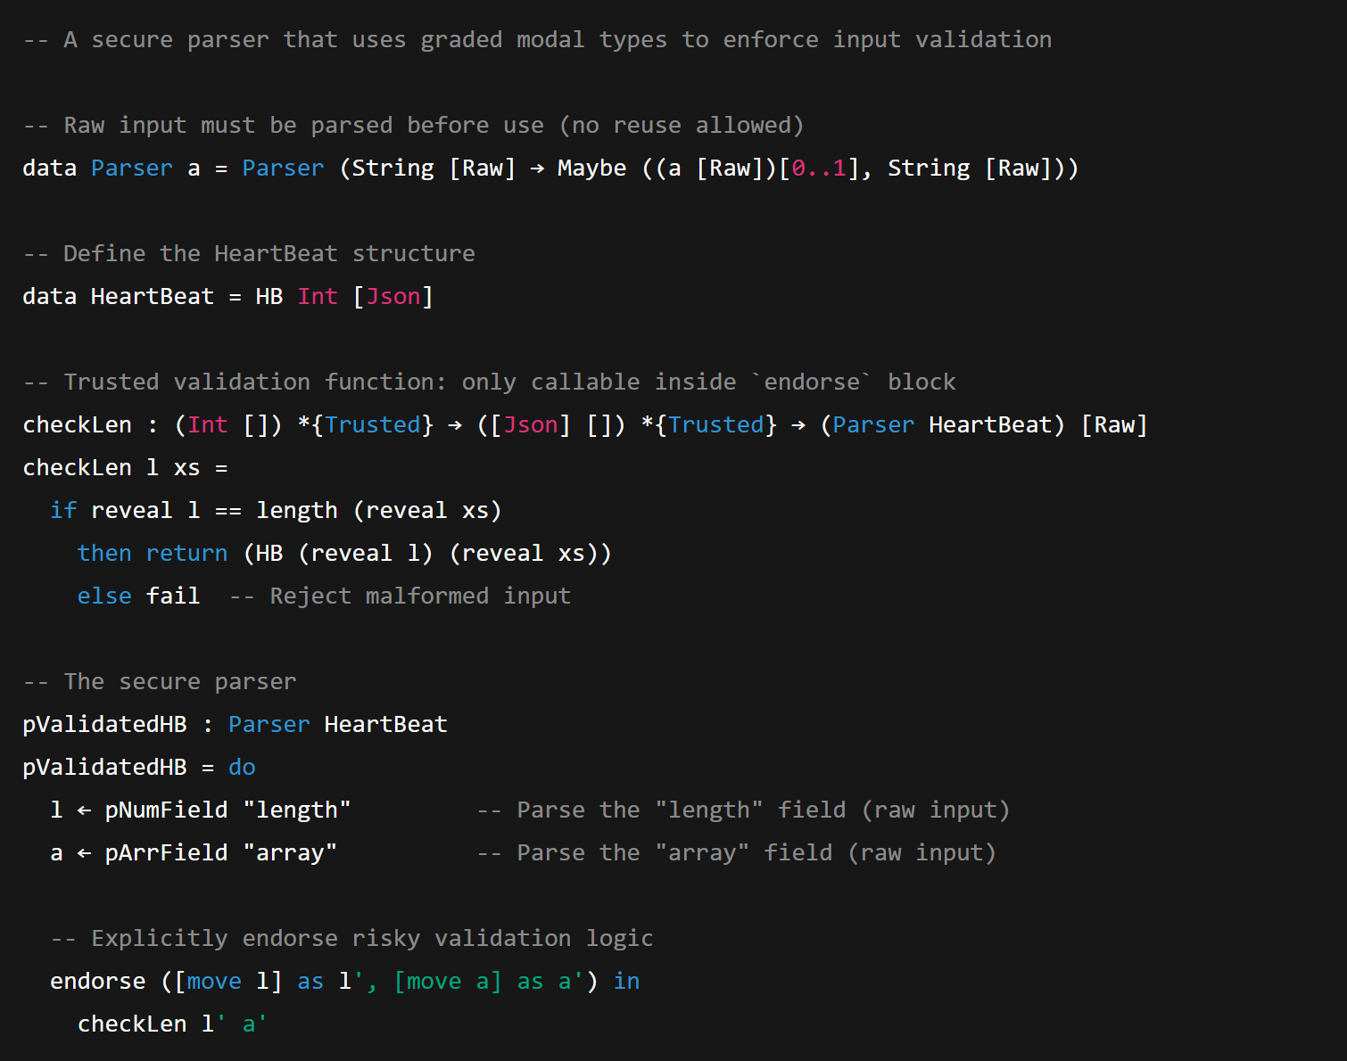
Code Example: Modal Guardrail Parser

Slide 7

Experiments & Evaluation
Test Environments
Network protocol parsers: HTTP, DNS, custom binary
Document format parsers: JSON, XML, custom formats
Database query interfaces: SQL, NoSQL
Attack Vectors Tested
Buffer overflow and memory corruption
Injection attacks (SQL, XSS, command)
Parser differential exploits
Denial of service through malformed input
Metrics Collected
Attack prevention rates by security level
Performance impact (latency, throughput)
Memory overhead by security level
Context transition costs
Code complexity metrics

Slide 8
Experimental Results
Key Findings
Context-appropriate security provides optimal security-performance balance
Security level transition overhead is negligible (< 0.5% of total processing)
Significant attack surface reduction even at permissive level
Security Effectiveness
Performance Impact
Security Level | Attack Prevention Rate | Attack Surface Reduction
Strict | 99.8% | 85%
Standard | 97.2% | 65%
Permissive | 89.5% | 40%
Security Level | Throughput Overhead | Memory Overhead
Strict | 12-18% | 15-20%
Standard | 5-8% | 8-12%
Permissive | 1-3% | 3-5%

Slide 9
Results & Conclusion
Key Contributions
Novel approach to context-sensitive parser security using modal logic
Formal framework for reasoning about security guarantees
Practical implementation architecture with empirical validation
Demonstrated viable security-performance tradeoffs
Security Improvements
Significant reduction in parser-related vulnerabilities
Enhanced security boundary enforcement between processing stages
Mathematically provable security properties at each level
Adaptable security measures appropriate to actual risk levels
Future Research Directions
Automated security level inference from code analysis
Integration with development toolchains
Application to emerging protocols and data formats

Slide 10
Commentary & Critique
Strengths
Strong theoretical foundation in modal logic and language theory
Practical implementation addressing real-world security challenges
Flexible approach adapting to actual risk levels
Performance-conscious design with acceptable overhead
Formal verification of security properties
Limitations
Significant implementation complexity requiring expertise
Challenges in retrofitting legacy systems
Security context determination logic as potential vulnerability
Higher resource requirements in constrained environments
Developer learning curve for modal logic concepts

Slide 11
Commentary & Critique
Industry Applicability
Particularly valuable for high-security applications (finance, healthcare)
Well-suited for multi-tenant systems and critical infrastructure
Could form basis for new security standards in parser implementation
Requires organizational commitment to formal methods

Slide 12
References
Bond, E., & Heimerdinger, M. (2023). Curbing the Vulnerable Parser: Graded Modal Guardrails for Secure Input Handling. In IEEE Secure Development Conference (SecDev 2023).
IEEE Secure Development Conference. (2023). 2023 Accepted Papers. https://secdev.ieee.org/2023/accepted/
LangSec.org. (2023). The Language-theoretic approach (LANGSEC). http://langsec.org/
Bratus, S., Patterson, M. L., & Sassaman, L. (2017). Language-theoretic Security (LangSec). OWASP Summit 2017.
Patterson, M. L. (2017). Input Handling Done Right: Building Hardened Parsers Using Language-Theoretic Security. IEEE Cybersecurity Development.
Anantharaman, P. (2022). Protecting Systems From Exploits Using Language-Theoretic Security. Doctoral Dissertation, Dartmouth College.
Senier, A. (2023). The End of Binary Protocol Parser Vulnerabilities. Tutorial at IEEE Secure Development Conference.

Slide 13

Thank You
Questions?

